Slide 1


Zen Wealth
Financial Freedom and Security
Sources of Investment Return
January 2019
Zen Wealth LLP is an appointed representative of Best Practice IFA Group Limited which is authorised and regulated by the Financial Conduct Authority.

Slide 2

Sources of Investment Return
In this document, we will identify the broad asset classes which we believe provide positive returns for investment over long periods of time. We will look at the risk characteristics of these asset classes, as well as their expected return characteristics. We believe that an investor should only take risks that will produce a positive expected return on their investment.

Slide 3
Asset Classes
Growth of Wealth
1st January, 1988 – 31st December, 2012
The variety of instruments an investor can use is vast. The most conventional are shares, bonds and cash. These are classified as the major asset classes and are the most liquid and transparent which, in many cases, offer investors a real stream of income now or in the future. This quality gives them a tangible and genuine value.
In addition and where appropriate, we also consider property and commodities as separate asset classes in an attempt to offer additional diversification to a portfolio.
This graph shows what would have happened to the investment of £1 if you had invested into the major asset classes between 1st January 1998 and 31st December 2012. Please note we have used UK One-Month Treasury Bills to represent the growth of cash.
£23.22
£10.64
£8.92
£6.64
£4.24
£2.39

Slide 4
Risk and Return are Related
Performance Summary
1st January, 1988 – 31st December, 2012
Statistics | United Kingdom Retail Price Index | UK One-Month Treasury Bills | MSCI World Index | Dimensional Global Large Value Index | Dimensional Global Small Index | MSCI Emerging Markets Index
1-Year Total Return (%) | 3.09 | 0.35 | 11.41 | 15.92 | 11.83 | 13.41
3-Year Annualized Return (%) | 4.22 | 0.44 | 7.33 | 6.20 | 7.71 | 4.78
5-Year Annualized Return (%) | 3.19 | 1.33 | 3.56 | 1.36 | 4.03 | 3.54
10-Year Annualized Return (%) | 3.29 | 2.99 | 8.00 | 8.62 | 11.67 | 16.80
20-Year Annualized Return (%) | 2.91 | 4.39 | 7.02 | 9.33 | 8.53 | 8.44
Annualized Return (%) | 3.55 | 5.95 | 7.87 | 9.93 | 9.15 | 13.41
Annualized Standard Deviation (%) | 1.54 | 1.07 | 15.53 | 17.81 | 17.09 | 24.80
Growth of £100,000 | £238,914 | £424,069 | £664,736 | £1,065,460 | £891,980 | £2,325,409
Lowest 1-Year Return | -1.57% | 0.35% | -31.76% | -39.42% | -34.73% | -51.17%
 | (7/08-6/09) | (1/12-12/12) | (10/89-9/90) | (3/08-2/09) | (11/07-10/08) | (9/97-8/98)
Highest 1-Year Return | 10.91% | 15.93% | 63.19% | 82.37% | 76.06% | 86.20%
 | (11/89-10/90) | (10/89-9/90) | (9/92-8/93) | (9/92-8/93) | (9/92-8/93) | (1/89-12/89)
Lowest 3-Year Annualized Return | 1.78% | 0.44% | -17.79% | -15.84% | -12.15% | -20.29%
 | (1/99-12/01) | (1/10-12/12) | (4/00-3/03) | (3/06-2/09) | (3/06-2/09) | (9/95-8/98)
Highest 3-Year Annualized Return | 8.07% | 14.33% | 24.49% | 28.81% | 35.37% | 59.51%
 | (3/88-2/91) | (8/88-7/91) | (1/97-12/99) | (4/03-3/06) | (4/03-3/06) | (1/91-12/93)
This table shows the returns and standard deviations (representing ‘volatility’) of different asset classes over a range of different time periods.
Because risk and return are related, the higher expected return comes at a price and, as a consequence, investing in these companies is riskier than investing in the whole market. There are periods when these groups of shares underperform the market, but over time, the academic research indicates that these risk premiums have been worth paying for.

Slide 5

Portfolios should be built around structure, discipline and diversification
We do not use predictions, estimates or judgements to construct investment portfolios; instead, we look to world-renowned academic financial theory as a basis for our portfolio construction. We believe markets works, but (as we have mentioned previously) we are not prepared to accept the average rate of return from the market.
Following the whole market or sections of it through index-tracking funds is a worthwhile low-cost way to gain exposure to markets, but academic research identifies particular areas of the market that have reliably rewarded investors over time. These dimensions of higher expected return are explained later in this document in more detail and we build portfolios around these dimensions. Our aim is for our clients’ portfolios to beat the average investor, without taking the risk of relying solely on predictions or concentrating investments too narrowly.
Having identified these dimensions of higher expected return, we are careful to ensure that we keep our client’s exposure to them as high as possible. The funds that our clients are invested in are usually managed with the specific aim of maintaining the highest possible exposure to the dimension of higher expected return. This discipline can enhance investment returns.
Once we have helped clients decide upon their individual investment strategy, we stick to it strictly and do not allow it to stray with market movements.
In addition, we help our clients remain disciplined. Staying invested through thick and thin is usually the best strategy for investors, as timing exit and entry points is as unreliable as any other prediction of market movement. We help investors remain in the market all the time it remains appropriate to do so.

Slide 6
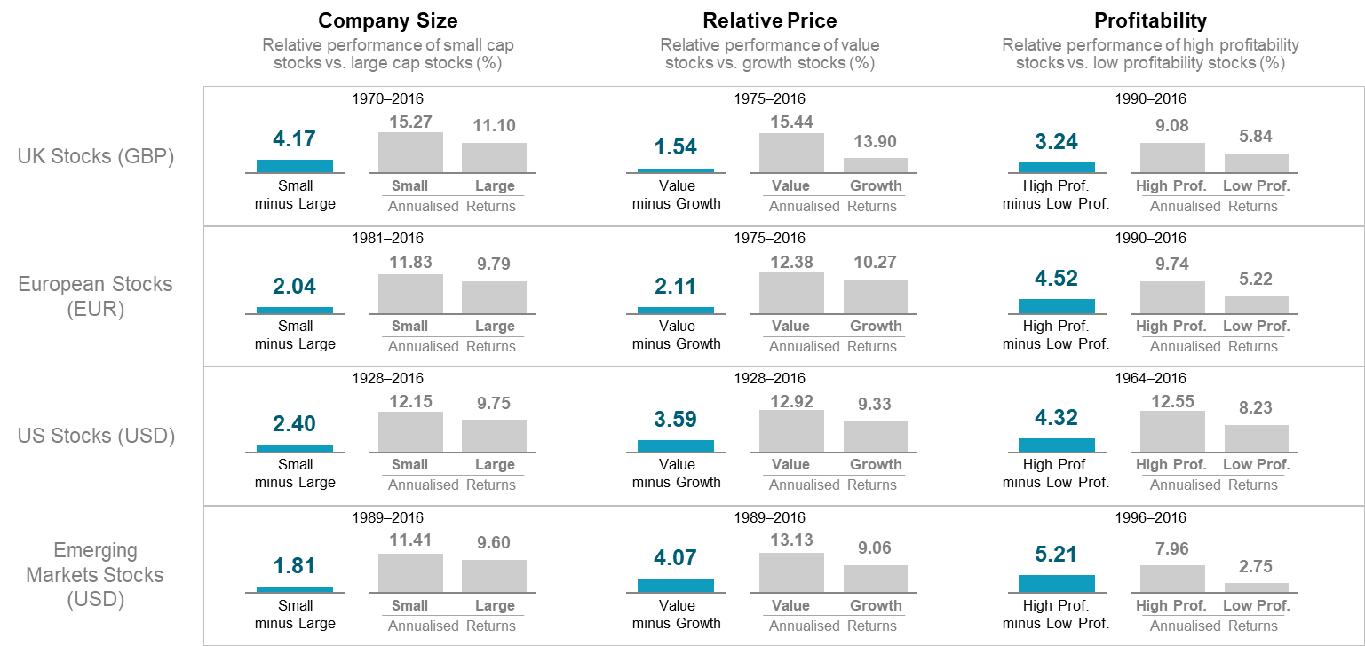
Dimensions of Higher Expected Return
Equities
In order to get the best possible equity market return, we focus clients’ exposure on dimensions of higher expected return that various academics have identified, notably Professor Gene Fama, of the University of Chicago Booth School of Business, and Professor Ken French, of the Tuck School of Business, Dartmouth College. Their research suggests that smaller companies and low-priced companies (that is companies whose book value of assets is high relative to their market price) perform better than the market average over time.
Because risk and return are related, the higher expected return comes at a price and, as a consequence, investing in these companies is riskier than investing in the whole market. There are periods when these groups of shares underperform the market, but over time, the academic research indicates that these risk premiums have been worth paying for.
The chart below shows how much these risk premiums have rewarded investors in comparison to an investment in the whole market in countries around the world. We therefore tilt our clients’ portfolios towards small and value companies, wherever possible, to the extent that is appropriate to the investor and their long-term goals.
This graph demonstrates the higher expected returns offered by small cap stocks and value stocks in the UK, Europe, US, and Emerging Markets.
Information provided by Dimensional Fund Advisors LP.
UK size Premium: Dimensional UK Small Cap Index (GBP) minus MSCI UK Index (gross div., GBP). UK relative price premium: Fama/French UK Value Index minus Fama/French UK Growth Index. UK profitability premium: Dimensional UK High Profitability Index minus Dimensional UK Low Profitability Index. Europe size premium: Dimensional Europe Small Index (EUR) minus MSCI Europe Index (gross div., EUR). Europe relative price premium: Fama/French Europe and Scandinavia Value Index minus Fama/French Europe and Scandinavia Growth Index. Europe profitability premium: Dimensional Europe High Profitability Index minus Dimensional Europe Low Profitability Index. US size premium: Dimensional US Small Cap Index minus S&P 500 Index. US relative price premium: Fama/French US Value Index minus Fama/French US Growth Index. US profitability premium: Dimensional US High Profitability Index minus Dimensional US Low Profitability Index. Emerging Markets size premium: Dimensional Emerging Markets Small Cap Index minus MSCI Emerging Markets Index (gross div.). Emerging Markets relative price premium: Fama/French Emerging Markets Value Index minus Fama/French Emerging Markets Growth Index. Emerging Markets profitability premium: Dimensional Emerging Markets High Profitability Index minus Dimensional Emerging Markets Low Profitability Index.Profitability is measured as operating income before depreciation and amortisation minus interest expense scaled by book. Indices are not available for direct investment. Their performance does not reflect the expenses associated with the management of an actual portfolio. Past performance is not a guarantee of future results. Returns may increase or decrease a result of currency fluctuations. Index returns are not representative of actual portfolios and do not reflect costs and fees associated with an actual investment. Actual returns may be lower. See “Index Descriptions” in the appendix for descriptions of Dimensional and Fama/French index data. Eugene Fama and Ken French are members of the Board of Directors for and provide consulting services to Dimensional Fund Advisors LP. The S&P data are provided by Standard & Poor’s Index Services Group. MSCI data © MSCI 2017, all rights reserved.

Slide 7
Bonds
Similarly, academic research indicates that fixed income, or bond investments exhibit two risk premiums: duration (the length of time until the bond matures); and how credit-worthy the bond issuer is. In principle, longer term bonds and those issued by companies with a lower credit rating are more risky, but pay a higher yield. How we use fixed income in our portfolios is explained in the portfolio construction section.
Property
One of the reasons to consider investing in property is that both commercial and residential property investment have produced very good returns compared with the other core asset classes. Although these returns have been poor since 2007, they still compare favourably over the long term. The IPD UK Property Index annualised return from 01/1987 to 02/2014 was 8.72% compared to 1.01% from 01/2007 to 02/2014.
Commercial property offers the potential of predictable long-term income with the opportunity for some capital growth. In general, commercial property should be seen as a long-term investment that offers slightly more risk than gilts, and less risk than equities, in return for returns that are higher than gilts, and less than equities.
Residential property has offered even higher returns, but most of this has been in the form of capital gains through rising house prices and, as a result it has historically been less reliable than commercial property.
Further, because property as an asset class offers diversification, it offers different performance characteristics and low correlation compared with the other core asset classes. See further questions on diversification for more information.
Whilst Property therefore qualifies as a ‘natural’ asset class, it has certain characteristics which are worthy of note:
It is a difficult asset class to capture passively.
Although Real Estate Investment Trust (REIT) funds are available as collective investments - mostly as Exchange Traded Funds (ETF’s) - their structure can be unsuitable for regular premium investors.
Unlike equity and bond market indices which are updated daily based on the movement of prices in the market, property indices such as the Investment Property Databank (IPD) index are only updated quarterly. Consequently, it cannot be said that the asset price is derived from an efficient market process which is subject to daily market pricing.
Funds investing directly into property are not always liquid and can restrict an investor’s ability to redeem funds when asset values are adversely affected by market conditions.
While not directly related to the dynamics of portfolio construction, many investors already have a significant exposure to property in their overall net worth.
Commodities
Commodities are a very different asset class from equities, bonds or cash, as while they are investable assets, they are not capital assets. Commodities do not generate a stream of dividends, interest payments, or other income that can be discounted in order to calculate a net present value. Commodities are valued because they can be consumed or transformed into something else which can be consumed.
Historically, there have been many routes investors have used to gain commodity exposure. The most common approach has been via an equity investment in an exchange-listed commodity producing company.
Other vehicles have included owning physical assets such as forests, precious metals or investing in resource-economy currencies such as the Australian and Canadian dollars.
However, the emergence of commodity index products as well as Exchange Traded Funds (ETF’s) over the past years has increased the popularity of commodity exposure via these routes.
One of the benefits of investing in commodities via an index or an ETF is that an investor can gain exposure to a broad range of commodities, which tends to enhance diversification, reduce volatility and maximise the Sharpe ratio. Equity investment, meanwhile, has tended to be unable to give broad exposure to the entire commodity index. Rather, it provides an investor exposure to just one sector or simply one commodity.
Commodities are all items which can be replaced. Any time that a commodity becomes too expensive, corporations start to figure out how to do without it. A case in point is the evolution of the hybrid engines, which started to gain traction when oil prices were shooting up.
We do not recommend that commodities be held as part of our core portfolio. However, we do believe that in certain instances there are diversification benefits in holding the asset class. However, this judgement will be made on a case by case basis. Commodities do not often move in tandem with stocks and bonds, this means when implemented as part of a larger portfolio and regularly rebalanced they can smooth returns within a portfolio and reduce volatility.
Where it is agreed that commodities should be included within the portfolio a discussion will be had on the best way to access the asset class, with individual research being undertaken based on the agreed method of investing.
Hedge Funds, Absolute Return Funds and Structured Products
We regard the returns generated by hedge funds and other esoteric and opaque strategies to be synthetic. That is to say fabricated from the natural components of capital markets but modified with, perhaps borrowing or derivatives to produce a different type of return. These are strategies, not asset classes. In addition, they are complex, expensive and less liquid than the investments we normally prefer to use in our portfolios. We therefore do not consider these types of structures within our portfolios.
However, we will, where individual circumstances may benefit from this type of approach, utilise these investments to help meet specific objectives.

